Slide 1
Automating Builds in Git on IBM i
Sanjula Ganepola
Software Developer
sanjula.ganepola@ibm.com

Slide 2
Agenda
The Modern Development Lifecycle with Git
Git Tooling and Automation
Unlock Automated Builds with ibmi-ci
ILE Dependency Analysis with Source Orbit
Demo

Slide 3
The Modern Development Lifecycle with Git

Slide 4

What Does Modern Development Look Like?
WIP

Slide 5
Git Repository
WIP

Slide 6
Local Development Experience
WIP

Slide 7
Build Server
WIP

Slide 8
Git Tooling and Automation

Slide 9
Available Tools
WIP

Slide 10
Unlock Automated Builds with ibmi-ci

Slide 11
Overview
WIP

Slide 12
CLI Usage
WIP

Slide 13
GitHub Action Usage
WIP

Slide 14
ILE Dependency Analysis with Source Orbit

Slide 15
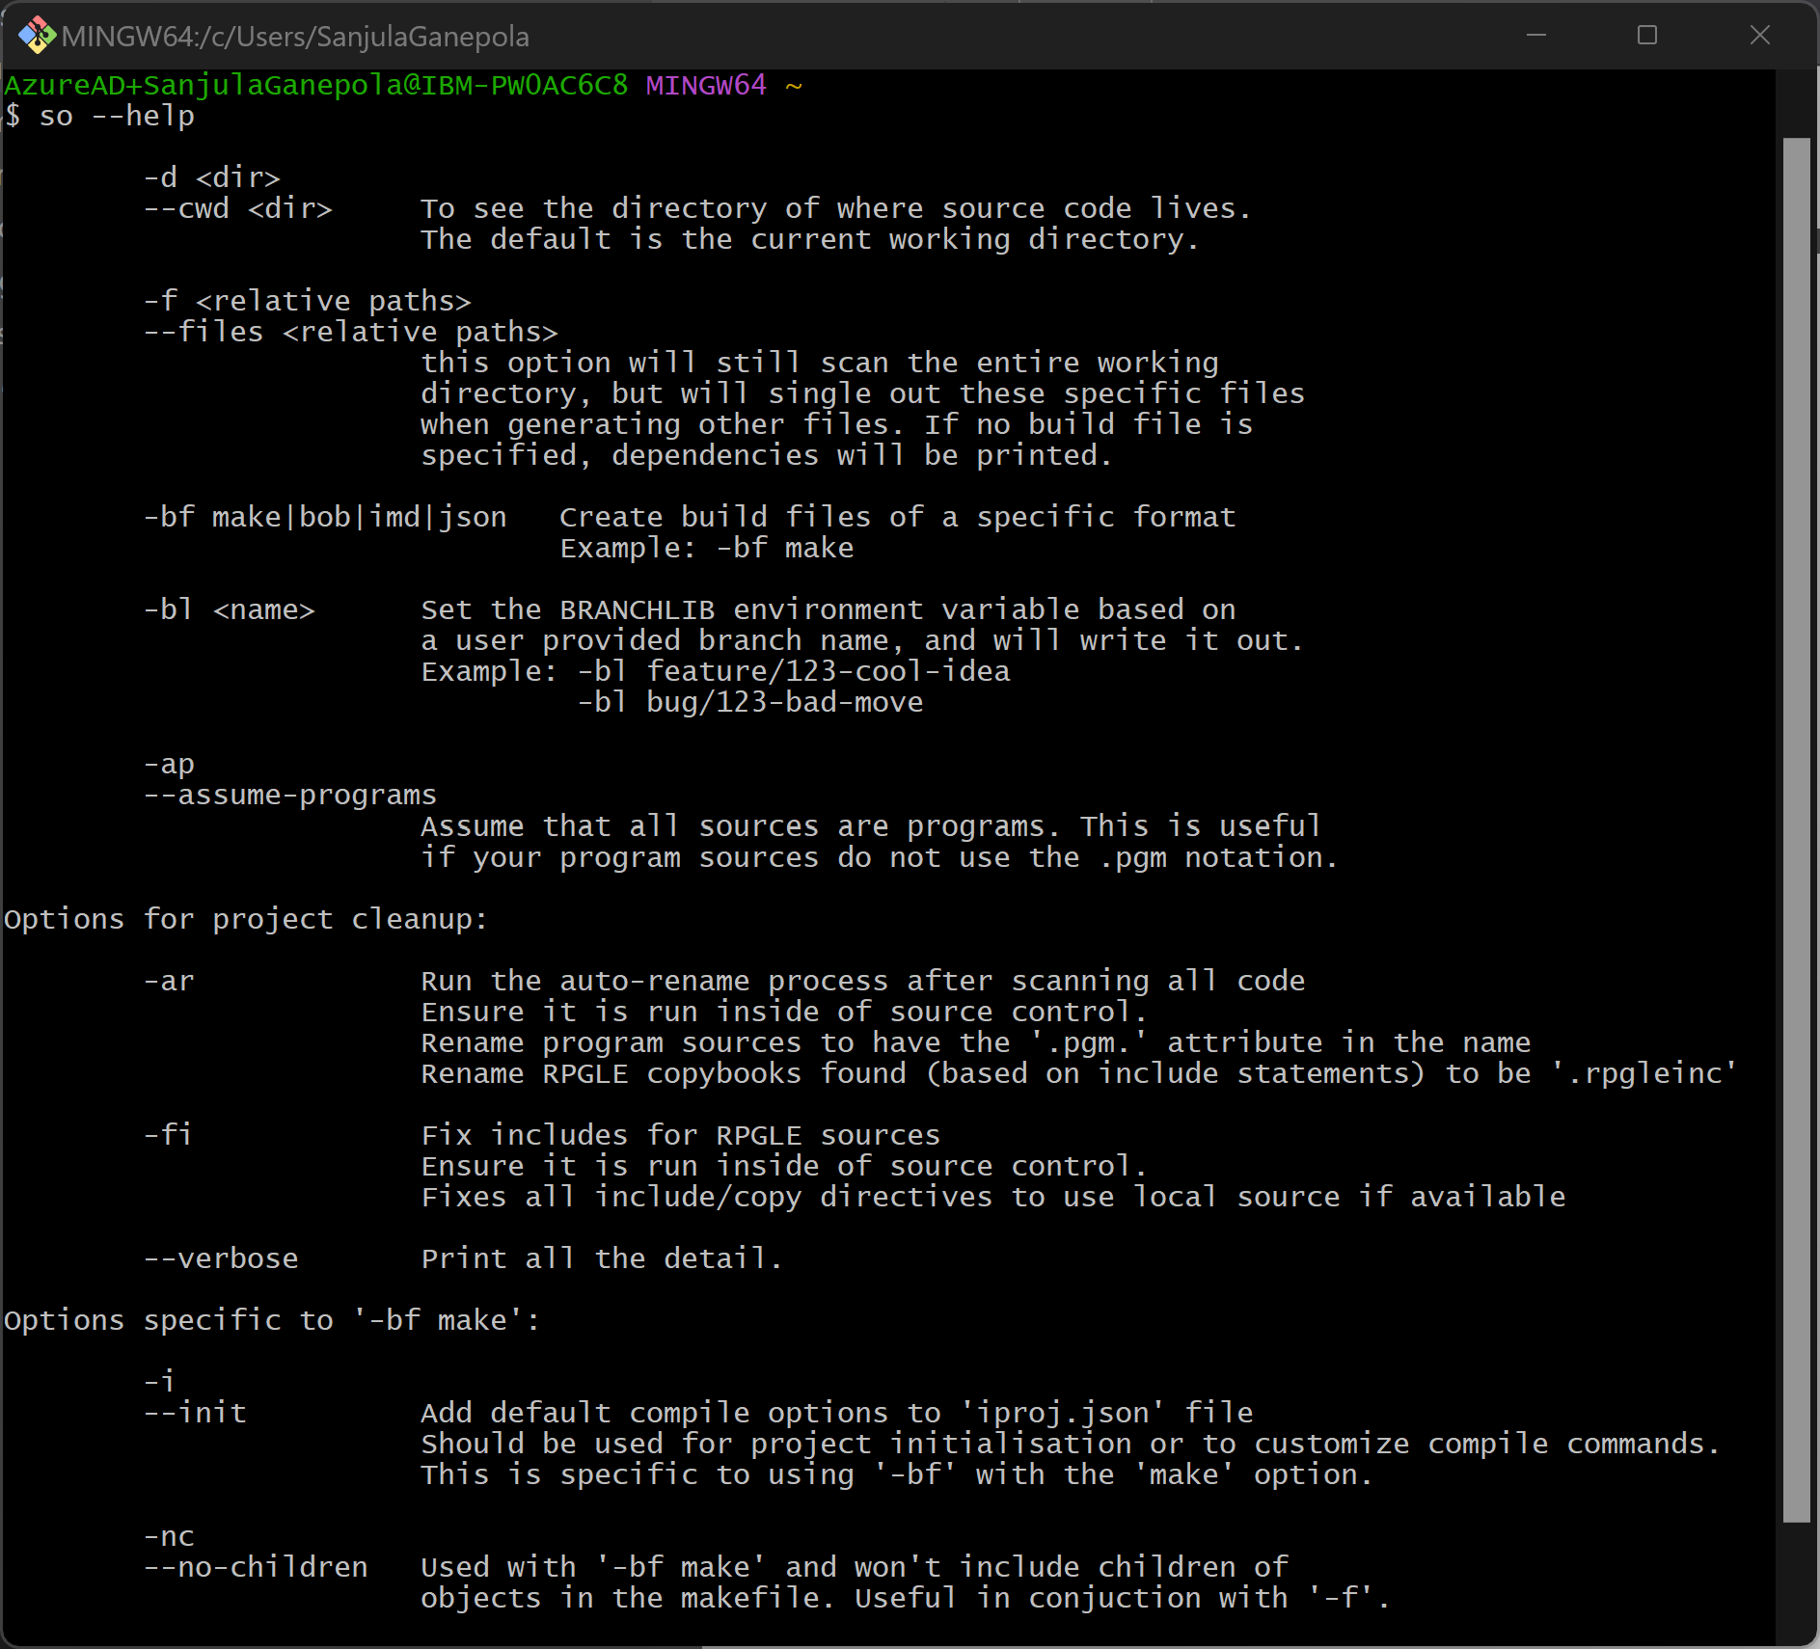
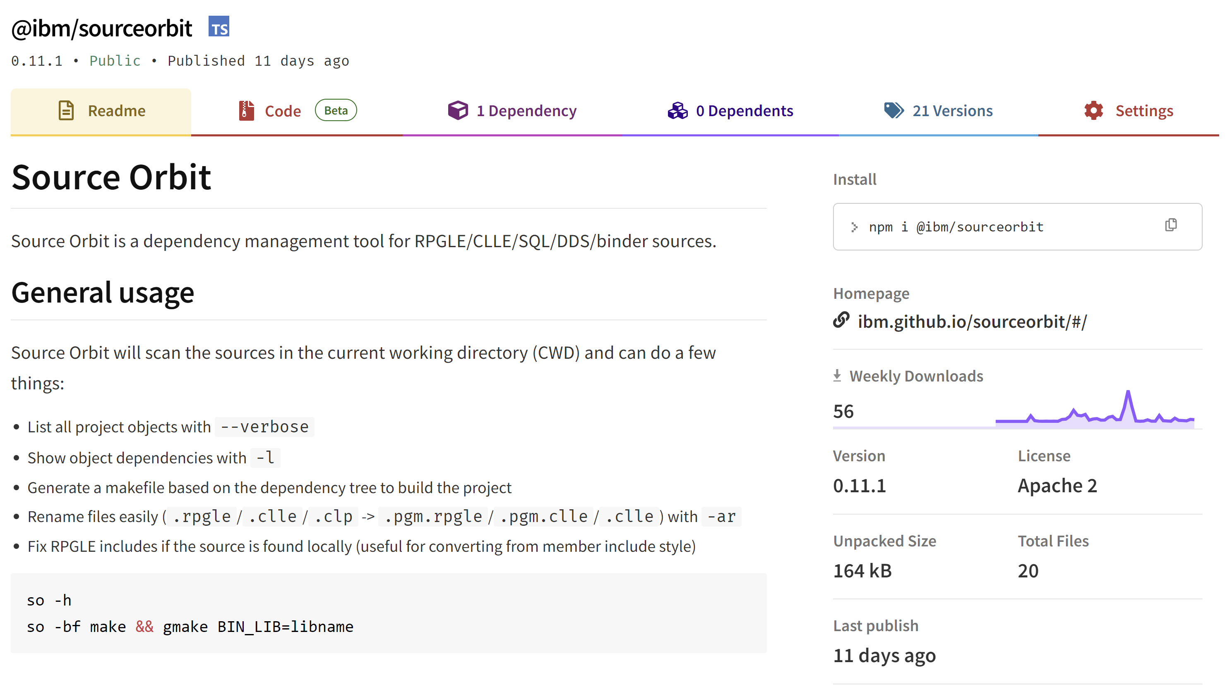
Overview
A dependency management CLI tool
Build dependency tree for RPGLE, DDS, SQL, CL, etc.
Generates impact analysis information
Generate scripts to automate builds
Clean up project

Slide 16
Let’s Dissect a Dependency Tree
WIP

Slide 17

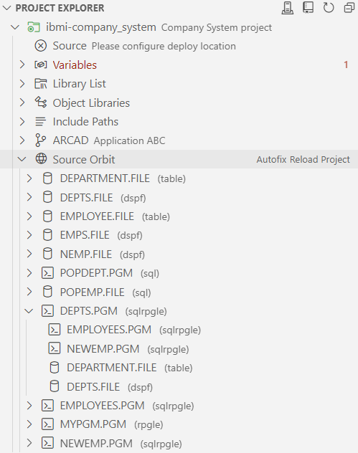
There is a Source Orbit VS Code Extension for Visualization!
Builds on top of IBM i Project Explorer
Visulize dependency tree
Source Orbit

Slide 18
Impact Analysis…What Objects am I Affecting?
WIP

Slide 19
Repository Cleanup
WIP

Slide 20
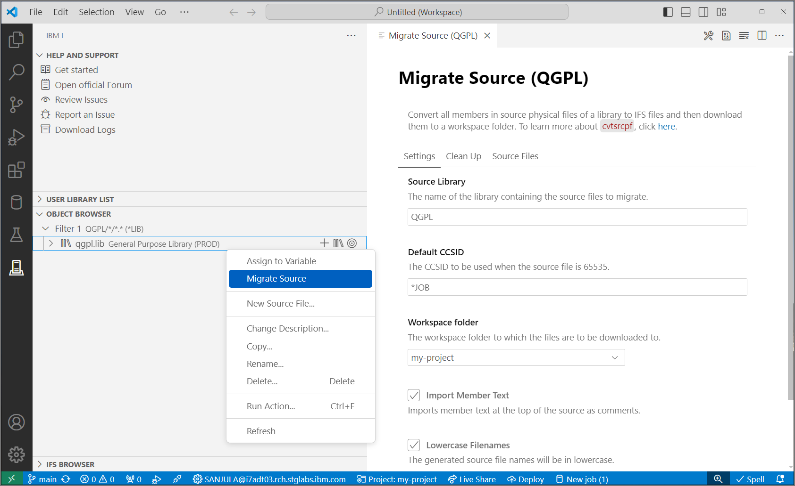

Integrated into IBM i Project Explorer
QSYS members in source physical files
↓
Properly encoded, terminated, and named source files in an IFS directory
↓
Download to local project
↓
Rename extensions
↓
Convert includes/copy directives to Unix style paths
CVTSRCPF from BOB
Source Orbit

Slide 21
CLI Usage
WIP

Slide 22
Usage in GitHub Action
WIP

Slide 23
Demo

Slide 24
Important Links
ibmi-ci
NPM https://www.npmjs.com/package/@ibm/ibmi-ci
GitHub Repository https://github.com/IBM/ibmi-ci
Source Orbit
Documentation https://ibm.github.io/sourceorbit/#/
GitHub Repository https://github.com/IBM/sourceorbit

Slide 25

For More Information
Links You Need | Twitter | #Hashtags
IBM i Home Page: https://www.ibm.com/it-infrastructure/power/os/ibm-i (find link to Forrester Study and updated IBM i Strategy Whitepaper) IBM Strategy Whitepaper: https://www.ibm.com/it-infrastructure/us-en/resources/power/i-strategy-roadmap/ IBM Client Success: https://www.ibm.com/it-infrastructure/us-en/resources/power/ibm-i-customer-stories/ Support Life Cycle: https://www.ibm.com/support/lifecycle/ License Topics: https://www-01.ibm.com/support/docview.wss?uid=nas8N1022087 Fortra IBM i Marketplace Survey https://www.fortra.com/resources/guides/ibm-i-marketplace-survey-results | @IBMSystems @COMMONug @IBMChampions @IBMSystemsISVs @IBMiMag @ITJungleNews @SAPonIBMi @SiDforIBMi | #PowerSystems #IBMi #IBMAIX #POWER9 #LinuxonPower #OpenPOWER #HANAonPower #ITinfrastructure #OpenSource #HybridCloud #BigData

